Slide 1
Triggered Guitar Effects Platform: Design Review
Ralph Carlo Quinto (CE), Bryan Guner(EE), Haley Scott(EE)
Advisor: Dr. Ambrose Adegbege

Slide 2
Overview
Problem Identification
Project Goals
Team Breakdown
Project Overview
Video Demonstration
Detailed Specifications
Action Items
Milestones
Schedule
Budgets

Slide 3
Problem Identification
Guitar effects pedals restrain the guitar player to the area of the stage where their pedal board is located
Analog and digital effects pedals are more expensive than digital effects software

Slide 4
Project Goals
Analyze a sequence of notes (frequencies) played in time to cue control action
Trigger at user defined points
Concurrent effects
Tolerate inconsistencies in performance
Recognize trigger points within an acceptable latency

Slide 5
Team Breakdown
Bryan Guner | Team Lead - Develop a protocol for digital signal processing of the guitar signal in order to create a time-sequential record of the frequency content of the guitar signal and a comparison between pre recorded songs and live performances.
Ralph Quinto | Software Engineer - Research for possible programming platforms. Responsible for reading electric guitar signals, creating the signal analysis patches in pure data, and triggering digital guitar effects.
Haley Scott | Architectural Manager - Responsible for ensuring successful integration of project components, researching system methods, designing digital effects, Project and Organizational Management.

Slide 6
Detailed Specifications
Pure Data Specs
Sampling rate of 44,100 Hz
Block size of 1024
Electric Guitar: Ibanez RG5EX1
Bridge Pickup: Infinity 4
Magnet: Ceramic
DC Resistance: 15.6 KΩ
Gauges: .009/.011/.016/.024/.032/.042

Slide 7
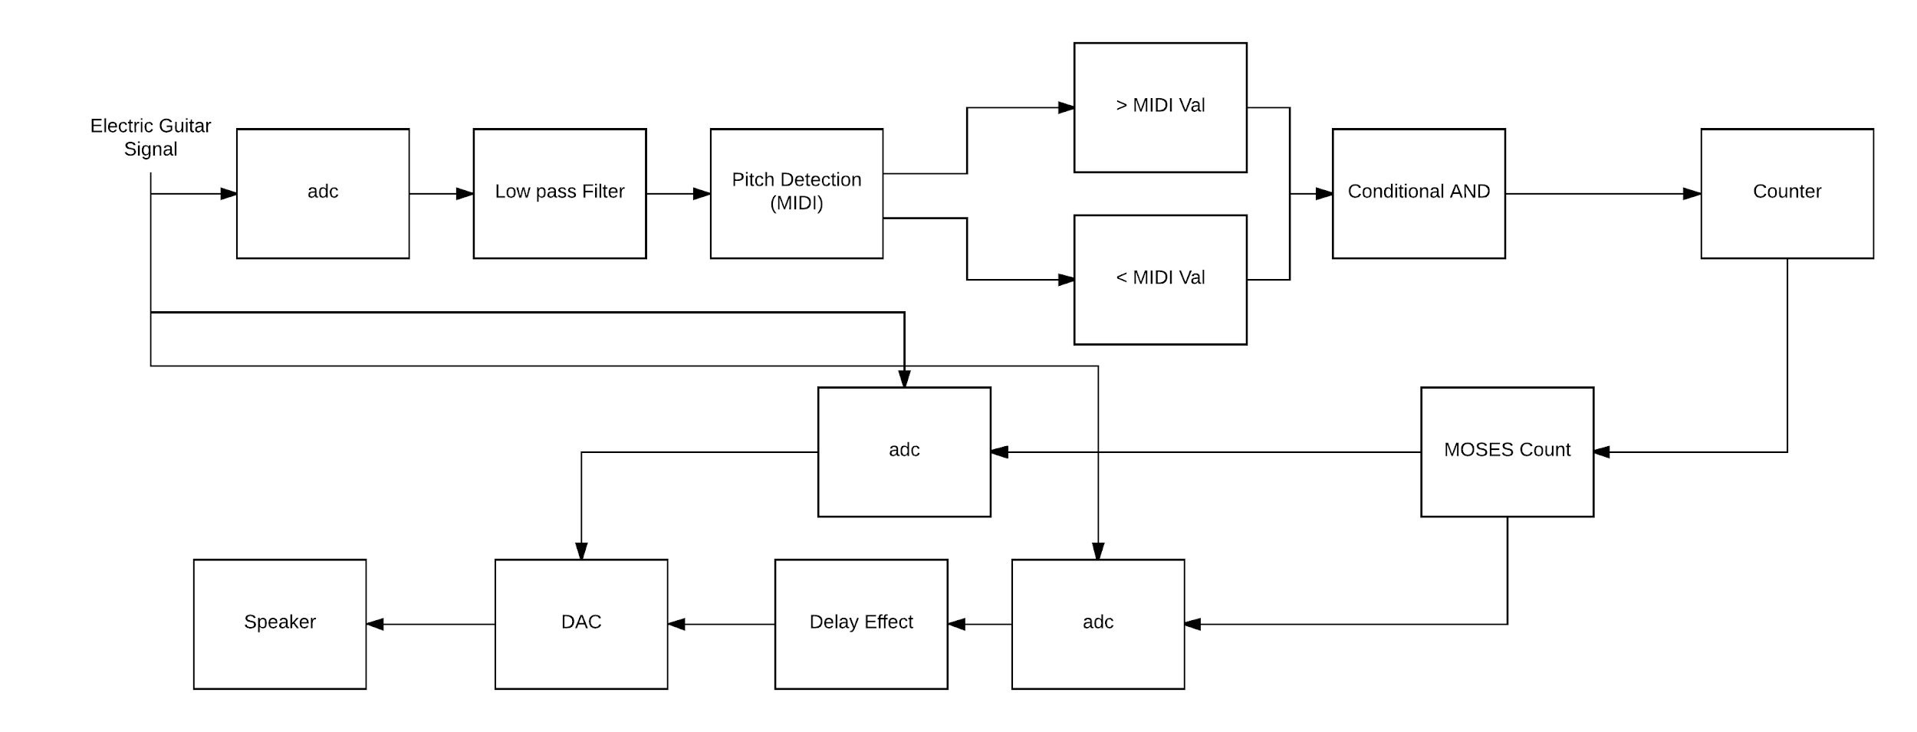
Project Overview

Slide 8
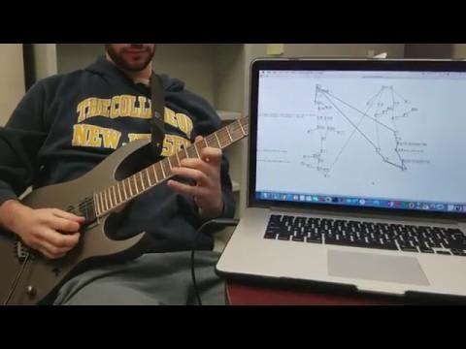
Video Demonstration (Current Model)

Slide 9
Open Action Items
Convert pseudo code algorithm into C
Import C code as Pure Data external
Design more complex digital effects

Slide 10
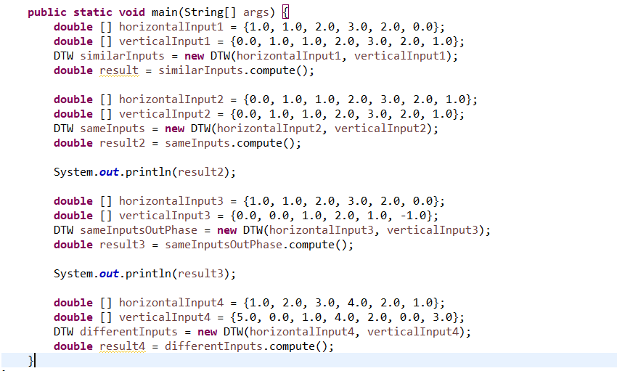
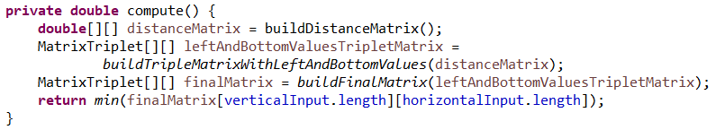
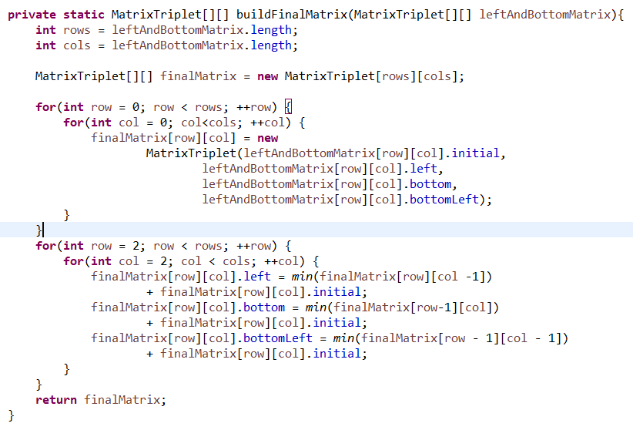
Converting Pseudo Code Algorithm to C

Slide 11

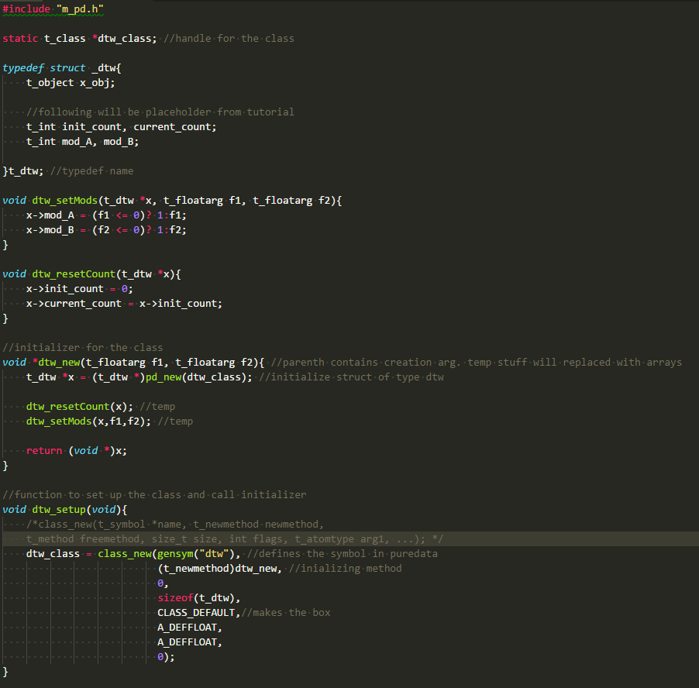
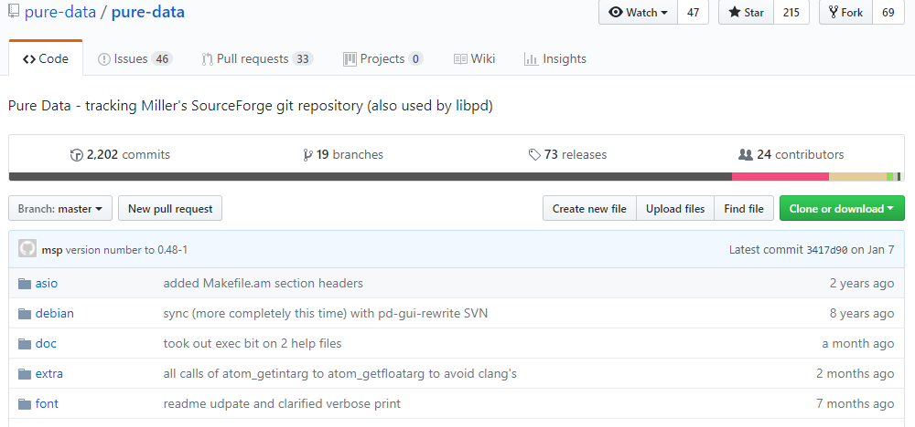
Converting Pseudo Code Algorithm to C Cont.

Slide 12
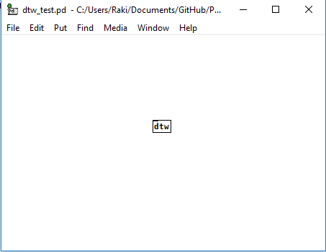


Generating DTW Pure Data External

Slide 13
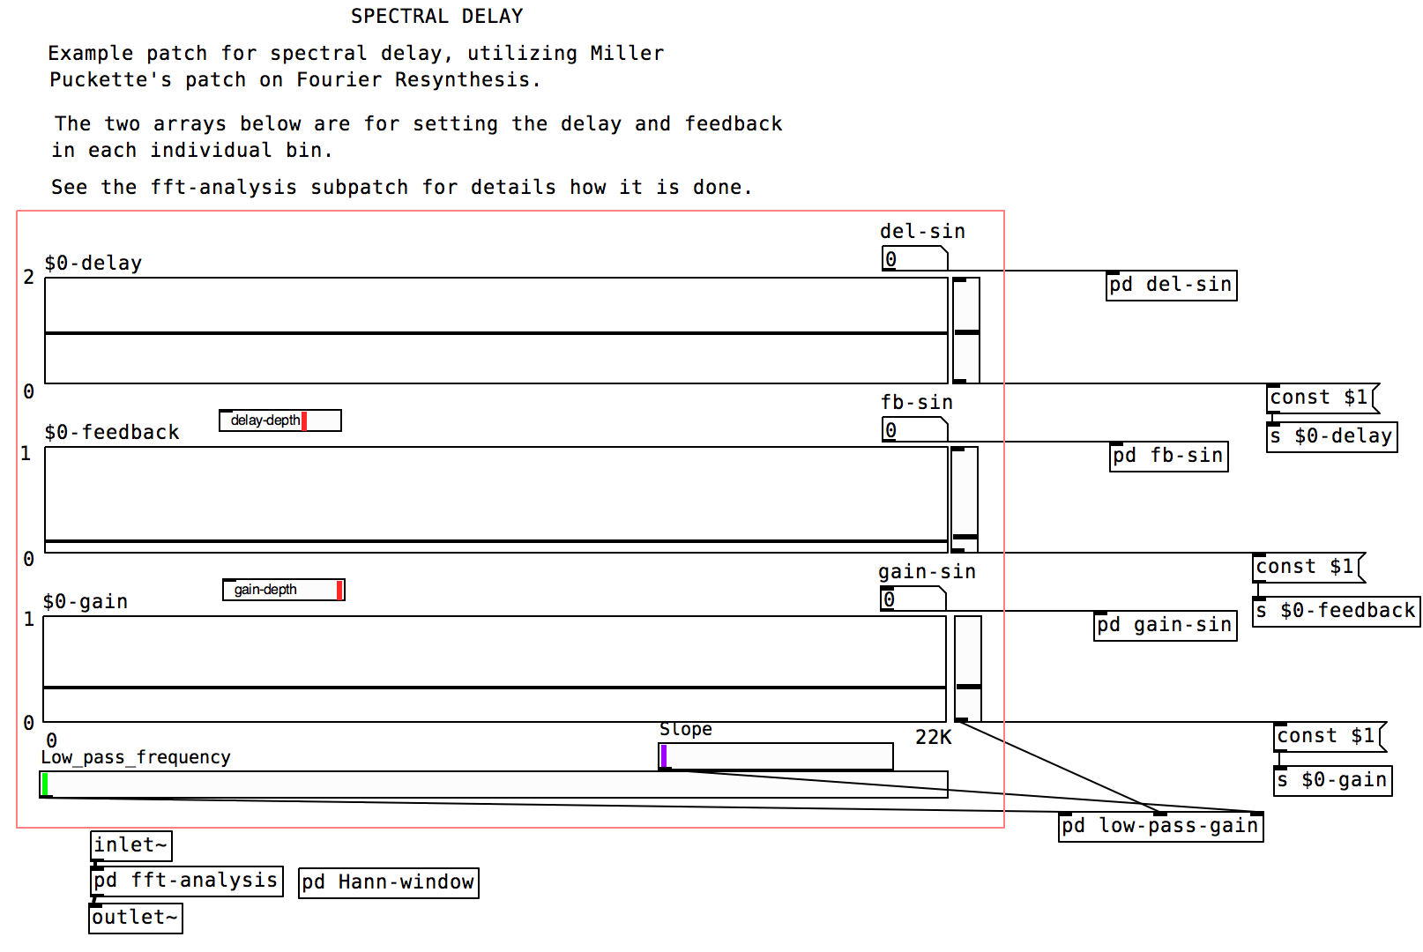
Designing Digital Effects

Slide 14
Anticipated Milestones
Integration of system components
Development of GUI
Testing and validation
Modification and improvement

Slide 15
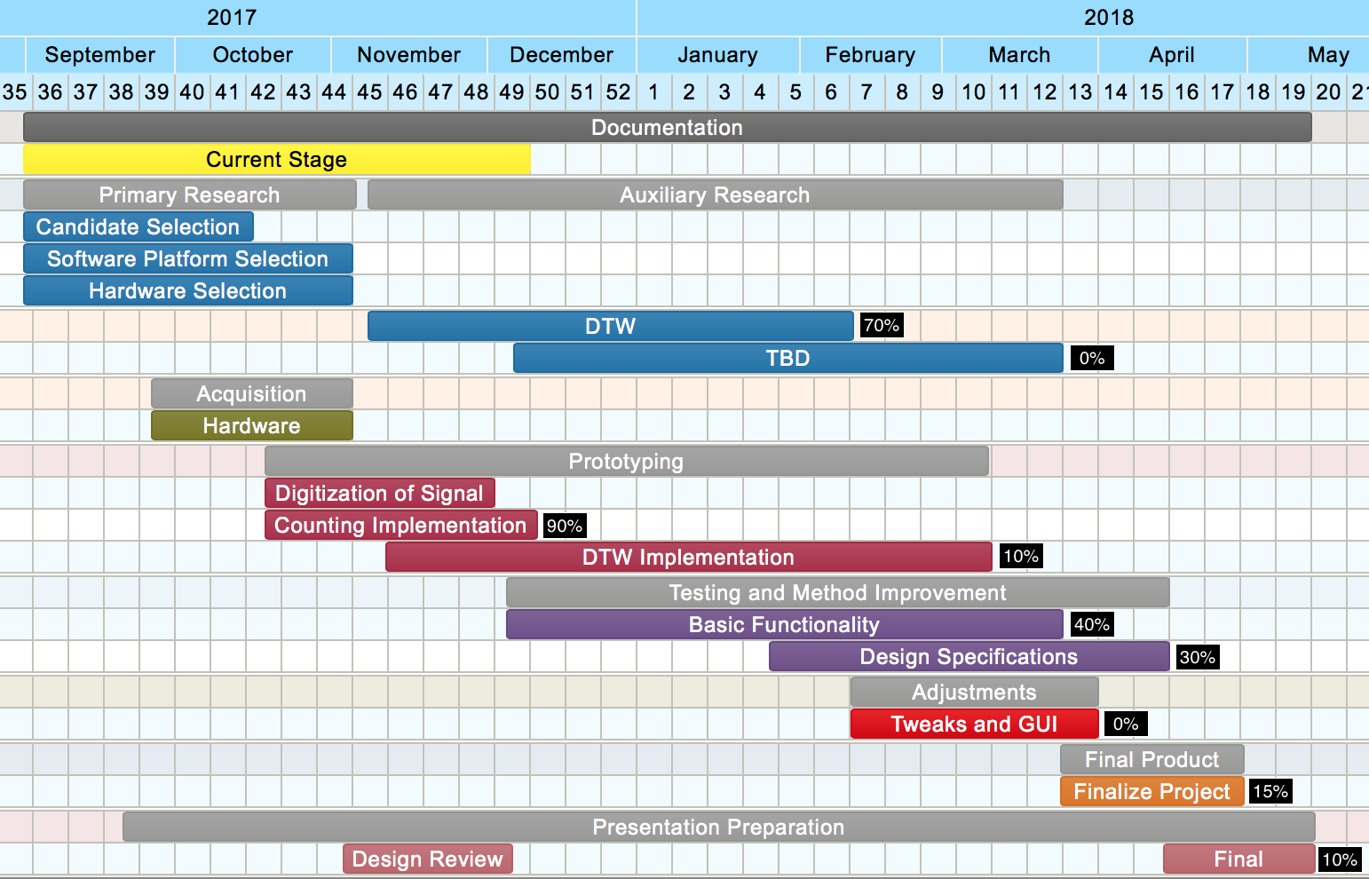
Schedule

Slide 16
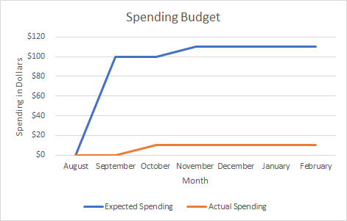
Spending Budget

Slide 17
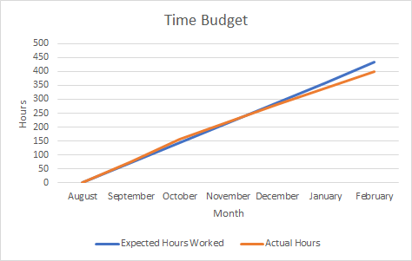
Time Budget

Slide 18
Budget
Items Purchased
USB to Quarter Inch Cable ($10)
Items Available
Electric Guitar
Guitar Amplifier
Laptop
Pure Data Software

Slide 19
Summary
To eliminate performance drawbacks posed by guitar stomp boxes
Created a simplified automatic guitar effects trigger system
Capable of triggering Delay Effect
Plan on implementing Dynamic Time Warping Patch
Meeting Design Criteria
Trigger Latency of <= 1 second
Minimum Note Onset separation of 10 notes per second
Concurrent/Multiple Effects Triggering Events

Slide 20

Questions

